Slide 1
15-6 Surface Area

Slide 2
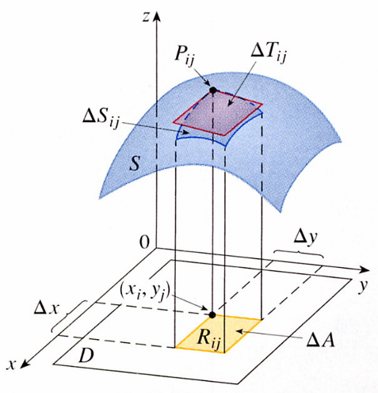

S be a surface z = f(x, y), f(x, y)≧０
R_{ij} with area △A =△x△y, (x_{i}, y_{j}) is the corner of R_{ij}
P_{ij}(x_{i}, y_{j}, f(x_{i}, y_{j})) the point on S.
z
The tangent plane to S at P_{ij}
P_{ij}
△T_{ij}
approximation to S near P_{ij}.
△S_{ij}
△T_{ij} ≒ △S_{ij}
S
Sum ΣΣ△T_{ij} ≒ the total area of S
0
△y
Define the surface area
y
(x_{i}, y_{j})
m n
△X
A(S) = lim ΣΣ △T_{ij}
R_{ij}
△A
m,n→∞
i=1 j=1
D
x

Slide 3
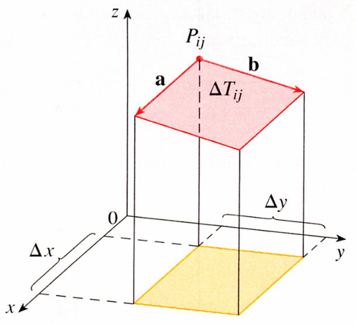
a and b be the vectors start at P_{ij}, △T_{ij} = ∣aXb∣
f_{x}(x_{i}, y_{j}) f_{y}(x_{i}, y_{j}) are the slopes of the tangent lines through P_{ij}.
a = △x i + f_{x}(x_{i}, y_{j})△x k
z = f(x_{i}, y_{j})
△z
△x
b = △y j + f_{y}(x_{i}, y_{j})△y k
z
i j k
= f_{x}(x_{i}, y_{j})
P_{ij}
z = f(x_{i}, y_{j})
△z
△y
i
a X b =
△x 0 f_{x}(x_{i}, y_{j})△x
a
b
= f_{y}(x_{i}, y_{j})
0 △y f_{y}(x_{i}, y_{j})△y
k
△T_{ij}
= -f_{x}(x_{i}, y_{j})△x△y i – f_{y}(x_{i}, y_{j})△x△y j + △x△y k
△y
= [-f_{x}(x_{i}, y_{j}) i - f_{y}(x_{i}, y_{j}) j + k]△A
△X
y
x

Slide 4
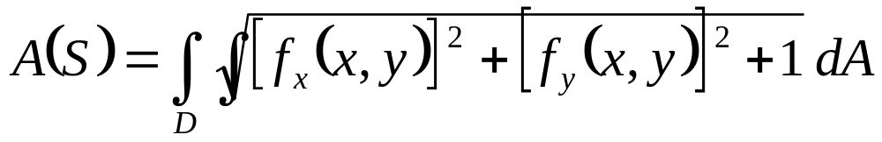
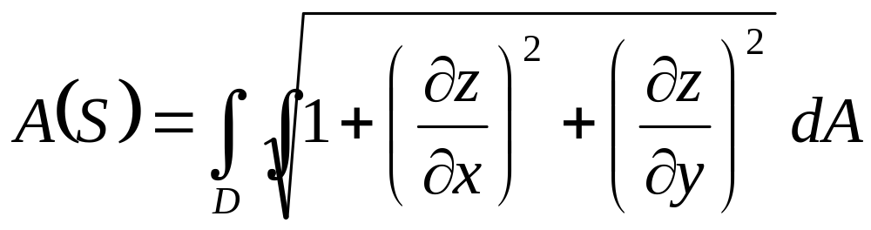
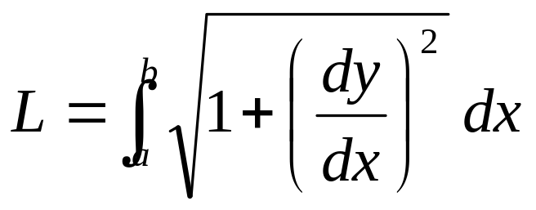

√
△T_{ij} = ∣a X b∣ = [f_{x}(x_{i}, y_{j})]² + [f_{y}(x_{i}, y_{j})]² + 1 △A
m n
A(S) = lim ΣΣ△T_{ij}
m,n→∞ i=1j=1
m n
A(S) = lim ΣΣ [f_{x}(x_{i}, y_{j})]² +[f_{y}(x_{i}, y_{j})]² +1 △A
√
m,n→∞ i=1j=1
z = f(x, y), (x, y) D,
f_{x} and f_{y} are continuous
2
(
)

Slide 5

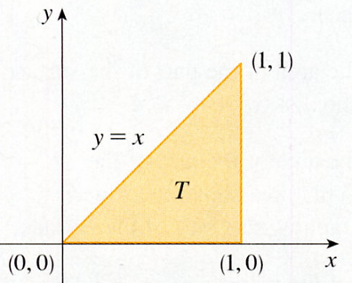


EXAMPLE 1 Find the surface area of the part of the surface z= x² + 2y that lies above the triangular region T in the xy-plane with vertices (0, 0), (1, 0), and (1, 1).
SOLUTION
T =｛(x, y)｜0≦x≦1, 0≦y≦x｝, f(x, y) = x² + 2y
√
A = 1 + (2x)² + (2)² dA
T
y
1
x
√
= 4x² + 5 dy dx
(1, 1)
0
0
y=x
T
(1, 0)
(1, 0)
x

Slide 6

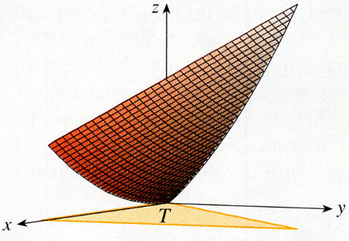
1
√
= x 4x² + 5 dx
0
1
= 1/8˙2/3 (4x² + 5) ^{3/2}]
0
√
= 1/12(27 – 5 5 )
z
y
x
T

Slide 7
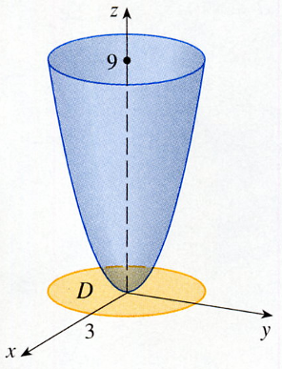

EXAMPLE 2 Find the area of the part of the paraboloid z = x² + y² that lies under the plane z = 9.
SOLUTION
√
αz
αz
A =
1 + ( )² + ( )² dA
αx
αy
D
√
y
= 1 + (2x)² + (2y)² dA
D
√
= 1 + 4(x² + y²) dA
x
-3
0
3
9
D
2π
3
√
A =
1 + 4r² r dr dθ
0
0
2π
3
√
= dθ 1/8 1 + 4r² (8r) dr
0
0
D
3
√
= 2π(1/8)2/3(1 + 4r²)^{3/2}]
π/6 (37 37 – 1)
=
0

Slide 8
15-6 Exercises
EX9，EX12

